Slide 1
Predicting Future Sales
Team 20 - You Wu, Vanessa Guzman, Frank Wan, Elie Baaklini

Slide 2
Agenda
Overview
Critique of Other Competition Submissions
Our Solution
Final Prediction

Slide 3
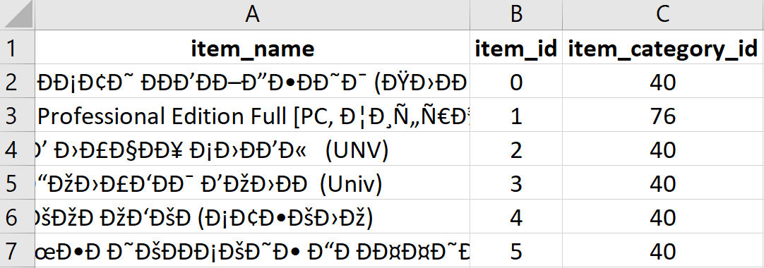
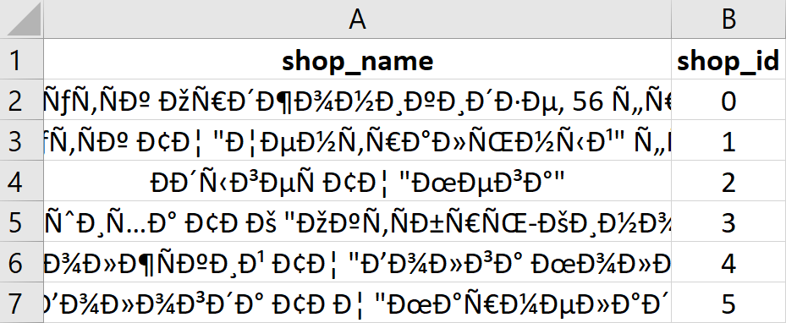
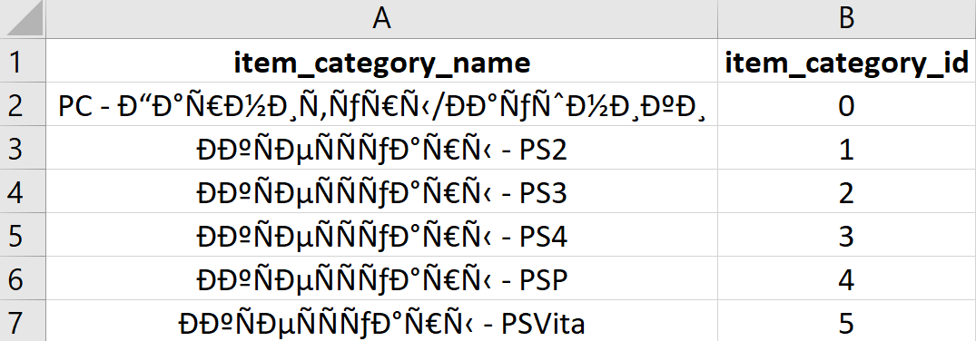
Overview
Objective: Predict total sales (quantity) for every product and store in the next month (November 2015)
Dataset: includes 6 csv files from 1C company (Russian software company)
items:
item_categories:
shops:
Notes:
(daily historical data from January 2013 – October 2015) -- 34 months
Columns such as item name, item category, shop ID, etc. do not change with time whereas item count and item price do vary with time.
This is time series data, there aren't many predictors, so we have to do some feature engineering
Data fields:
ID: sample submission file in the correct format
shop_id: unique identifier of a shop
item_id: unique identifier of a product
item_category_id: unique identifier of item category
item_cnt_day: number of products sold
item_price: current price of an item
date: date in format dd/mm/yyyy
item_category_name: name of item category
item_name: name of item
shop_name: name of shop

Slide 4
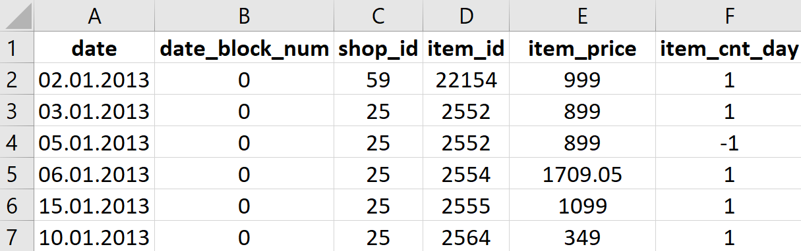
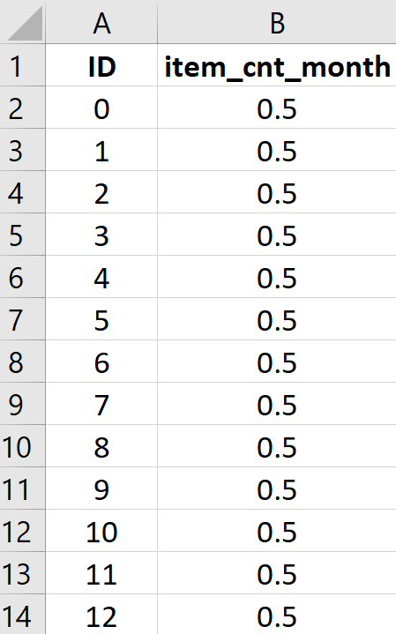
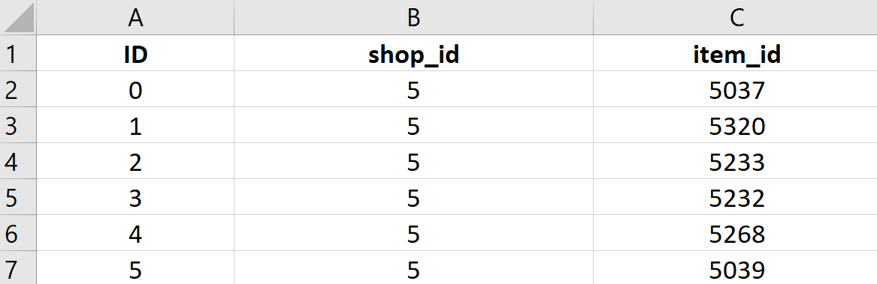
Overview
sales-train: training set
test: test set
sample: sample submission file in the correct format
Notes:
For each shop id we have the item id, price, and
Sample: ID is the primary composite key for every product and store combination

Slide 5
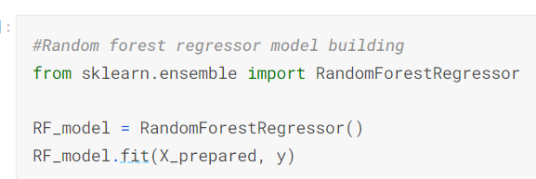
Critique of Other Competition Submissions
Random Forest
Pros:
Suitable for large dataset
Easy data preparation comparing to other algorithms
Cons:
Did not tune the hyperparameter
Computationally intense when number of trees is big
Will cause overfitting when noise is large
Lower output accuracy because it cannot guarantee the best tree
RMSE: 2.0182

Slide 6
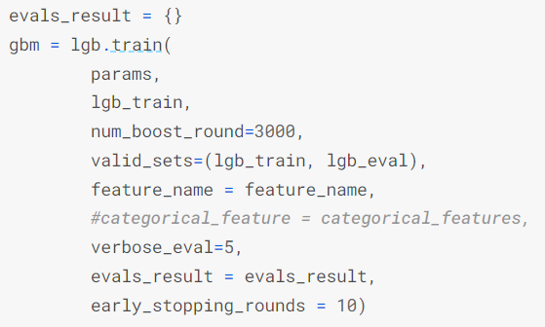
Critique of Other Competition Submissions
LightGBM (Light Gradient Boosting Machine)
Pros:
Faster training speed, Light GBM uses a histogram-based algorithm i.e it buckets continuous feature values into discrete bins which fasten the training procedure
Replaces continuous values to discrete bins which results in lower memory usage
Cons:
Light GBM split the tree leaf-wise which can lead to overfitting as it produces much complex trees
Did not do cross validation for hyperparameters
RMSE: 0.9610

Slide 7
Our Solution
XGBoost: eXtreme Gradient Boosting--"ALL in One" algorithm
As a popular supervised-learning algorithm, XGBoost uses decision trees as base learners; combining many weak learners to make a strong learner to speed up and increase the performance of gradient boosted decision trees
Regularization
Parallel Processing
Handling Missing Values
Effective Tree Pruning

Slide 8
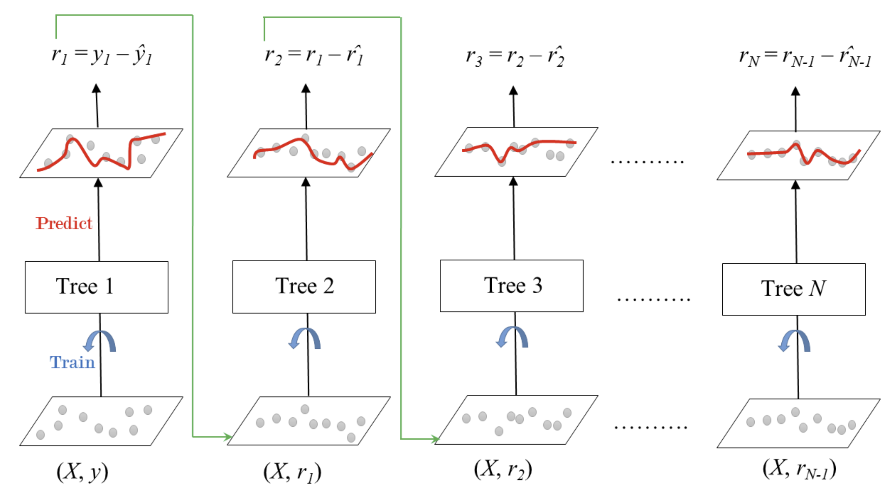
Our Solution
How does
XGBoost
work?
Notes:
Whole process is to repeat adding trees and splitting features to get a new tree. Every time we adding a new tree is to learn a new function and to fit for residual errors from last prediction. This process is repeated until all of the N trees forming the ensemble are trained. By adding all the values from each tree together, we get final prediction value. Our goal is to make y hat close to y in each step. Each optimization is based on the last result. In order to get rid of overfitting, we set specific values to max-depth, sample weight and threshold. As for early stopping, we need to find iteration number with the best evaluation metric value.

Slide 9
Our Solution
Flow chart
Data preparation
Explore data
Feature engineering
Make predictions
Evaluation using RMSE
Modeling

Slide 10
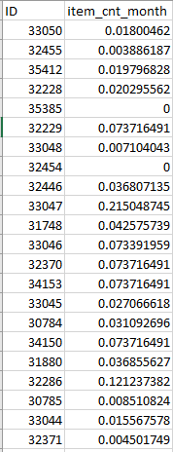
Final Prediction
Performance: RMSE=0.877
Final prediction results:

